Slide 1
Marketing Campaign Performance Analysis
Refining Strategies and Budget Allocations
Presented by: Abdelfattah Aboud
Date: 18.11.2024

Slide 2

Objective
Goal: Assess the effectiveness of various marketing campaigns to refine strategies and budget allocations.
Focus Areas:
Campaign performance metrics.
Demographic insights.
Visualization using Power BI.

Slide 3
Methodology
Campaign Metrics:
CTR, Conversion Rate, CPC, CPA, ROAS.
Channel Performance:
Evaluated metrics like average spend and conversions.
Demographic Analysis:
Examined performance by age, gender, and location.
Time-Based Analysis:
Monitored trends and seasonality across quarters.
Dashboard Insights:
Built visualizations for actionable insights.

Slide 4
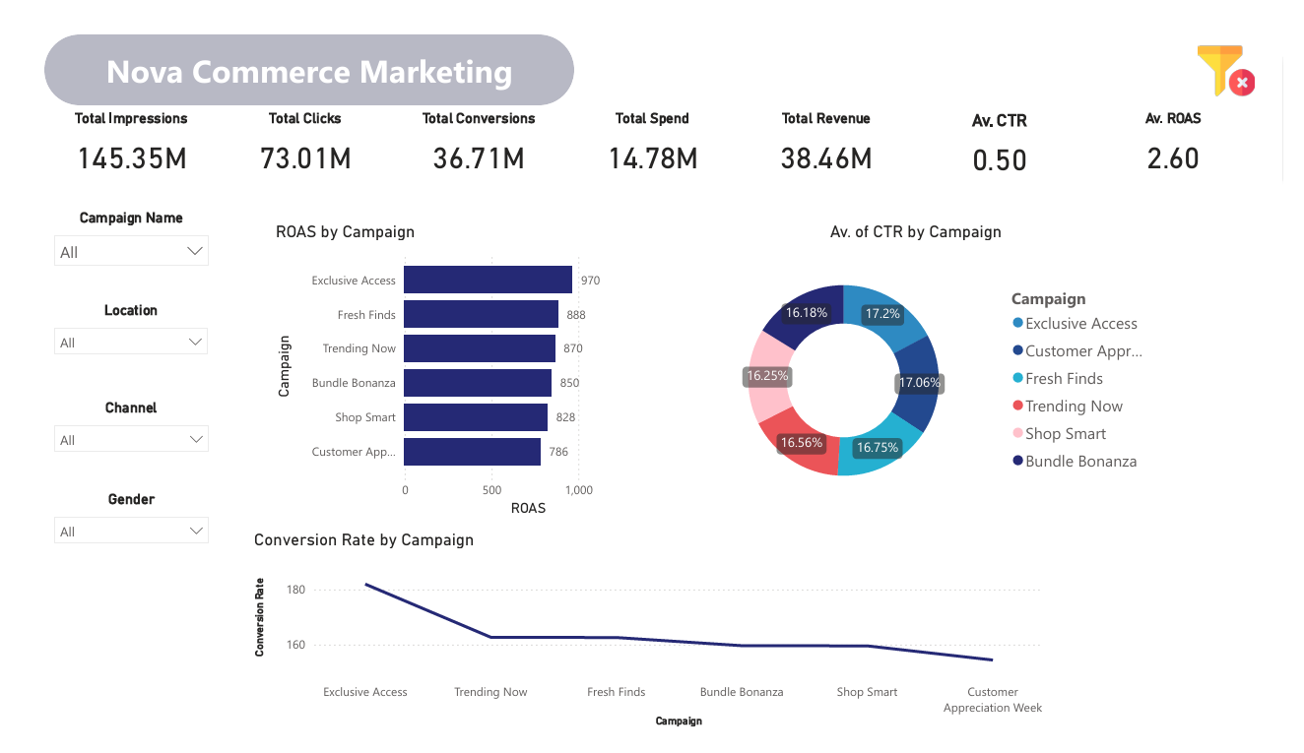
Overall KPIs Summary
Key Metrics:
Total Impressions: 145.35M
Total Clicks: 73.01M
Total Conversions: 36.71M
Total Spend: 14.78M
Total Revenue: 38.46M
Average CTR: 0.50%
Average ROAS: 2.60

Slide 5

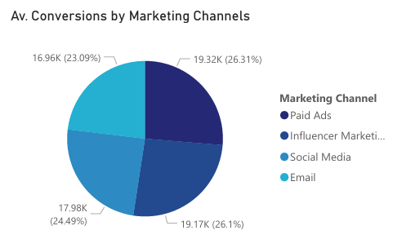
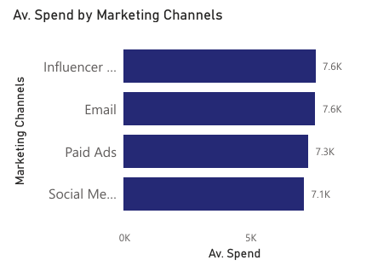
Channel Performance
Insights:
Channels with the highest Conversions:
Influencer Marketing (19.32K) and Email (19.17K)
Channels with the highest Spend:
Influencer Marketing and Email (both 7.6K)
Paid Ads had the most impressions but comparatively lower ROAS.

Slide 6
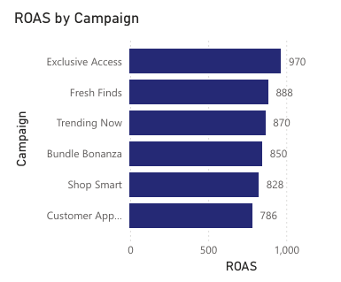
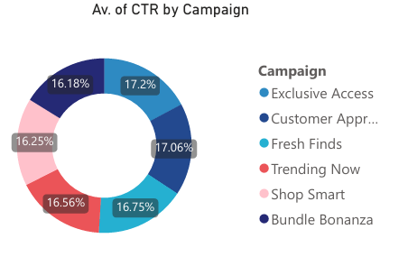
Campaign Key Performance
Key Findings:
Campaigns with the highest CTR:
Exclusive Access (17.2%) and Customer Appreciation Week (17.06%).
Campaigns with the highest ROAS:
Exclusive Access (970) and Fresh Finds (888)

Slide 7
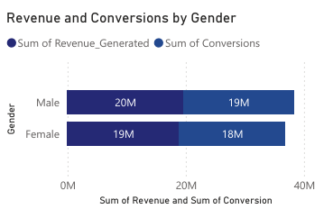
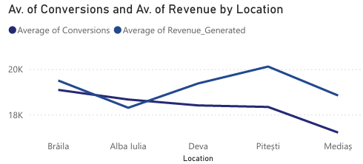
Demographics Analysis
Performance by Gender:
Revenue: Male (20M), Female (19M)
Conversions: Male (20M), Female (19M)
Performance by Age:
Highest revenue and conversions in the 35-44 age group.
Performance by Location:
Top-performing locations: Brăila and Pitești

Slide 8
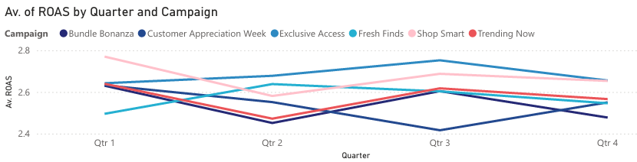
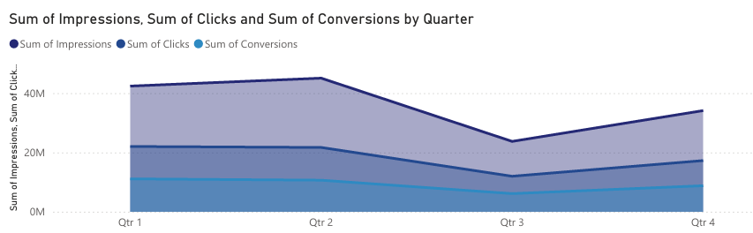
Time Based Analysis
Quarterly Insights:
Highest ROAS in Q3 (2.8)
Impressions, Clicks, and Conversions peaked in Q4.
Second Trends:
Consistent performance growth in Q3 and Q4.

Slide 9
Key Insights
1- Top-Performing Campaigns:
Exclusive Access and Fresh Finds excelled in both ROAS and CTR
2- Channel Highlights:
Influencer Marketing and Email channels had the best conversion rates
3- Demographics:
35–44 age group and males were the most profitable segments
4- Seasonality:
Q4 had the highest impressions and conversions.

Slide 10
Recommendations
1- Budget Allocation:
Invest more in high-performing campaigns like Exclusive Access.
Increase spend on Email and Influencer Marketing
2- Targeting Strategy:
Focus on 35–44 age group and top-performing locations like Brăila
3- Optimization::
Improve ROAS for Paid Ads and optimize low- performing campaigns

Slide 11
Campaign Performance Overview

Slide 12
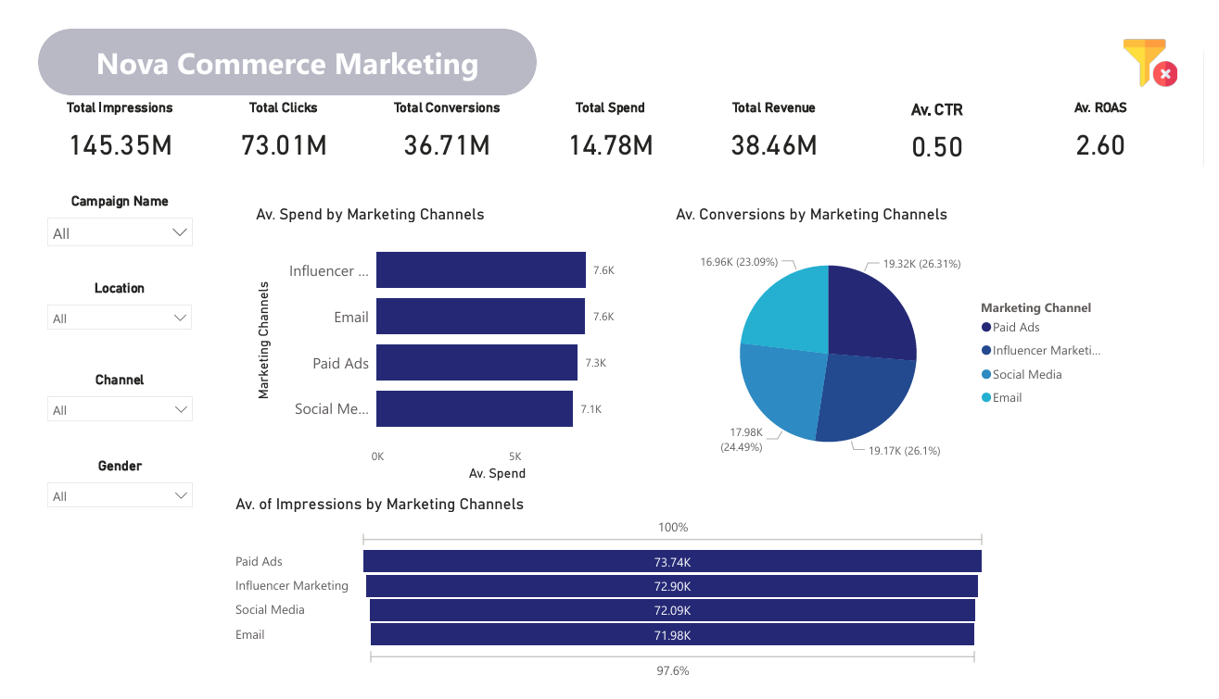
Channel Performance Breakdown

Slide 13
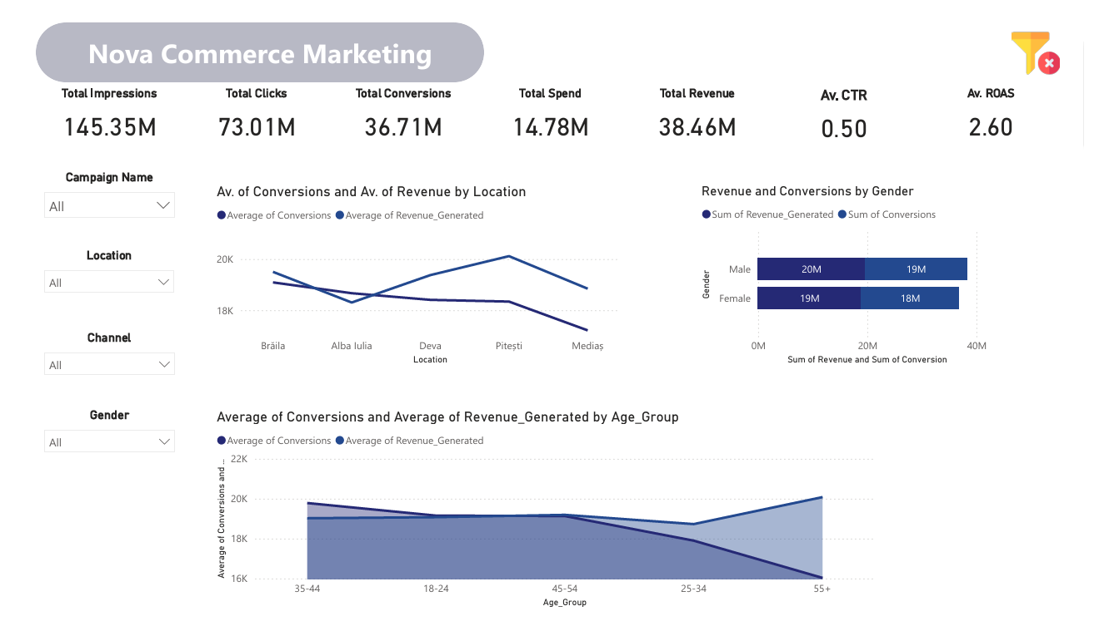
Demographics Insights

Slide 14
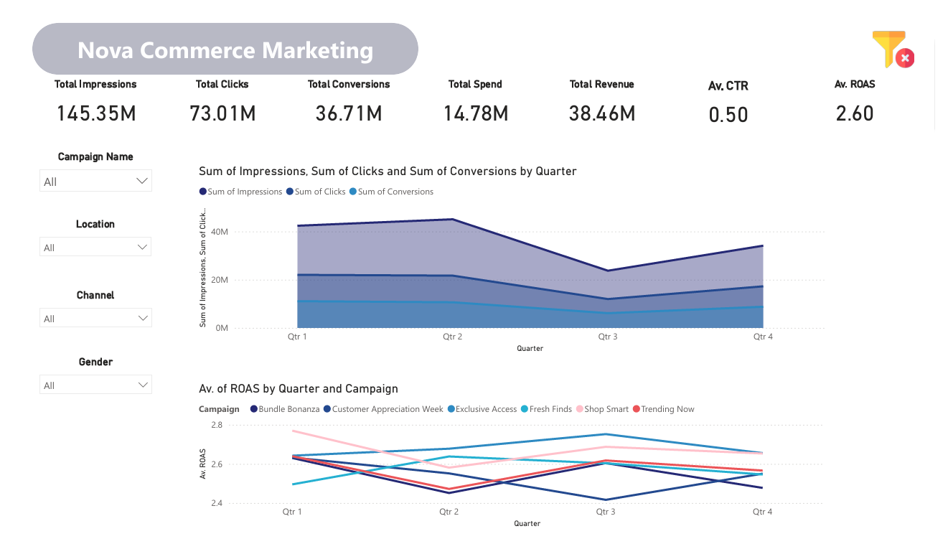
Trend Analysis

